Slide 1


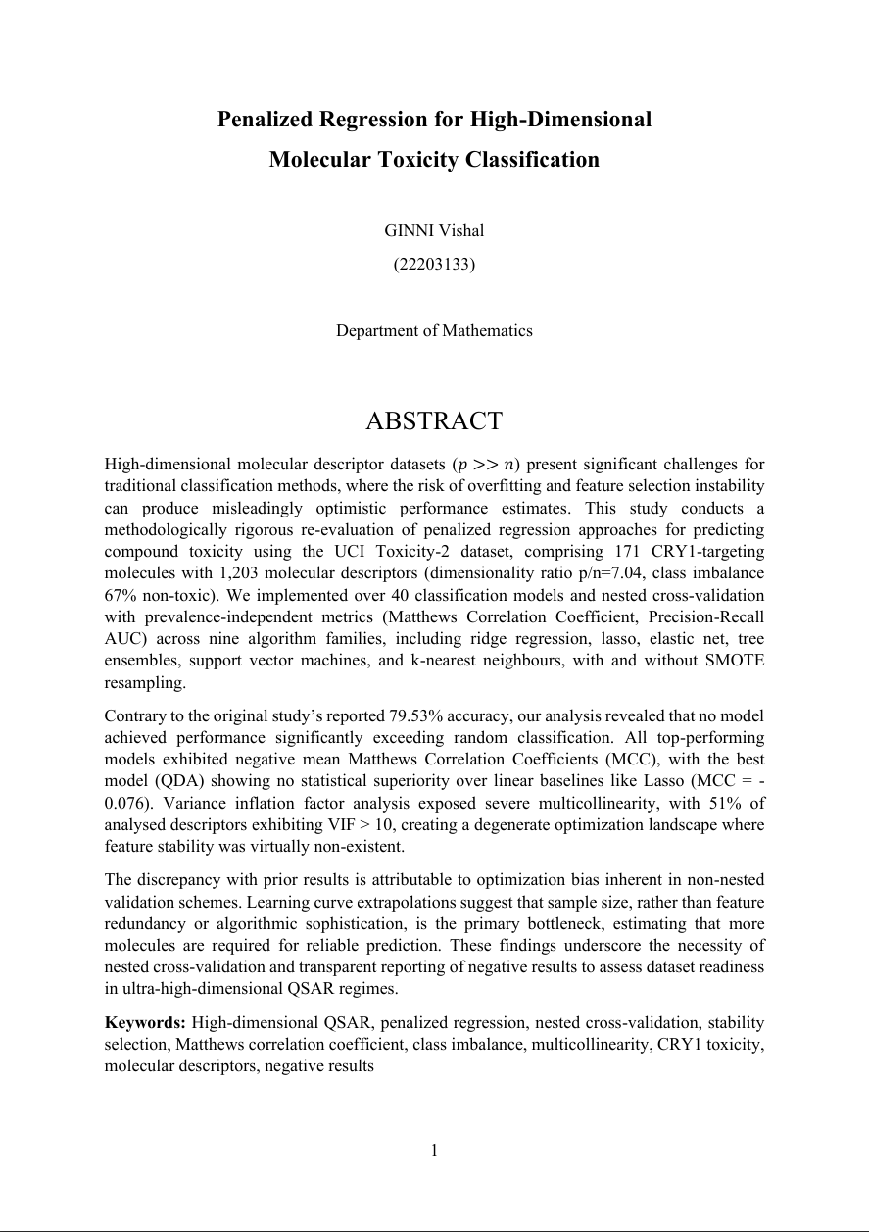

Overview
Background
Methodology
Nested CV
Results
Discussion
BSc (Hons.) in Mathematics & Statistics
PENALIZED REGRESSION FOR HIGH-DIMENSIONAL MOLECULAR TOXICITY CLASSIFICATION
GINNI Vishal (22203133)

Slide 2
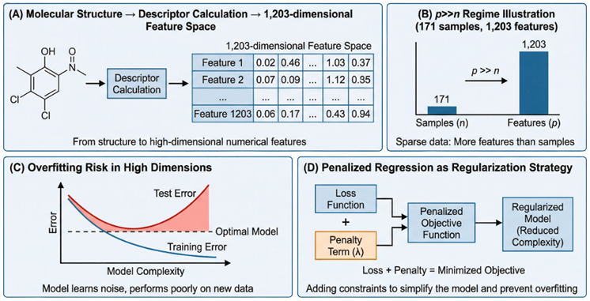
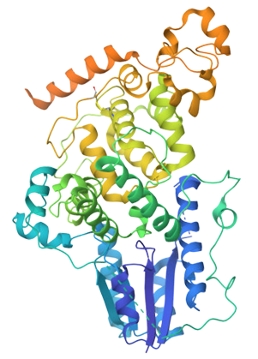
Overview
Background
Methodology
Nested CV
Results
Discussion
RESEARCH MOTIVATION
CRY1 (Cryptochrome 1): Target for circadian rhythm disorders
Sleep disorders, metabolic disease, cancer relevance
QSAR Modeling: Predict toxicity from molecular descriptors
Computational drug discovery (faster, cheaper than lab screening)
The p >> n Challenge: 1,203 descriptors vs. 171 molecules
High-dimensional regime (p/n = 7.04) → Overfitting risk
Prior Study Claim: 79.53% accuracy (Gul et al., 2021)
But used non-nested CV → Optimization bias likely!
Figure 1: Conceptual Overview of High-Dimensional QSAR
RESEARCH QUESTIONS
Can penalized regression (Lasso, Ridge, Elastic Net) reliably predict CRY1 toxicity in this ultra-high-dimensional setting?
How does nested cross-validation change our conclusions compared to standard validation?
What is the actual sample size needed for reliable prediction?
How severe is multicollinearity among molecular descriptors?
Figure 2: Crystal structure of mouse cryptochrome 1 (CRY1), a core circadian clock protein, shown from the RCSB PDB entry 4K0R

Slide 3
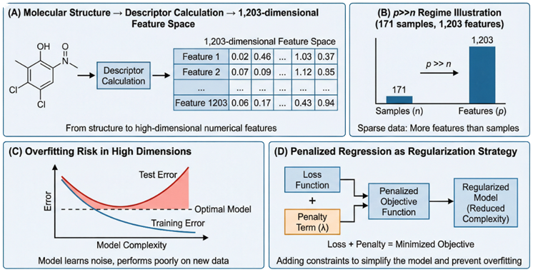
Overview
Background
Methodology
Nested CV
Results
Discussion
THE HIGH-DIMENSIONAL REGIME
Traditional Setting: p << n (More samples than features)
OLS works reasonably well
No overfitting issues
Our Problem: p >> n (p/n = 7.04)
Risk of learning noise rather than signal
Feature selection becomes unstable
Curse of dimensionality
Figure 3: High-Dimensional Regime Illustration
Figure 4: Overfitting Risk High-Dimensional Regime Illustration
WHY PENALIZED REGRESSION?
Ridge (L2): Shrink large coefficients → Reduce variance
Lasso (L1): Force coefficients to ZERO → Automatic feature selection
Elastic Net: Mix L1 + L2 → Best of both worlds
These methods add a "penalty" to constrain model complexity
→ Trade slight bias increase for large variance reduction
Figure 5: Regularization Illustration

Slide 4
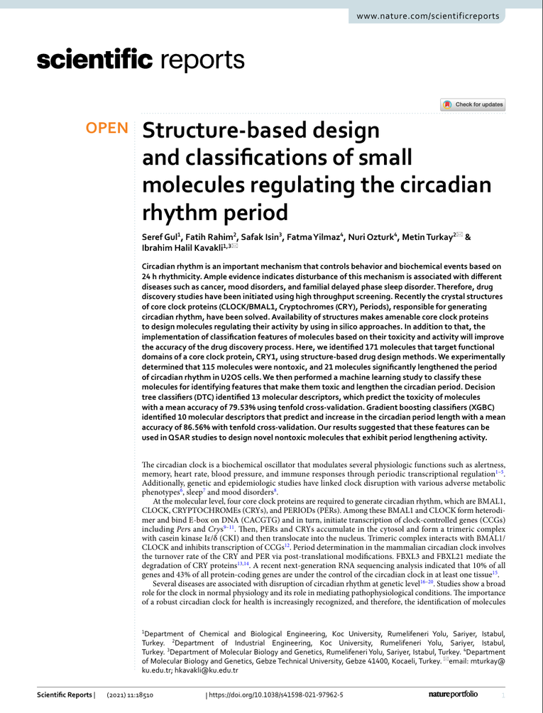
Overview
Background
Methodology
Nested CV
Results
Discussion
UCI TOXICITY-2 DATASET
EXPERIMENTAL DESIGN
171
1,203
Step 1
Feature Assessment
Variance Inflation Factor (VIF) analysis
Identify multicollinearity severity
n (samples)
p (features)
CRY1-targeting molecules
Molecular descriptors
Step 2
Model Implementation
7.04
67 : 33
50+ classification models across 9 algorithm families
Ridge, Lasso, Elastic Net, SVM, Random Forest, XGBoost, etc.
Dimensionality ratio
Class distribution
p/n = 7.04 (ULTRA-HIGH!)
67% non-toxic, 33% toxic
Step 3
NESTED Cross-Validation (5x5)
OUTER LOOP: 5-fold evaluation (test metrics)
INNER LOOP: 5-fold hyperparameter tuning
Step 4
Evaluation with Imbalance-Robust Metrics
Matthews Correlation Coefficient (MCC) [PRIMARY]
Precision-Recall AUC & Balanced Accuracy
Step 5
Feature Stability Analysis
Stability Selection with 100 bootstrap iterations
Identify "robust" vs. "noise" features

Slide 5
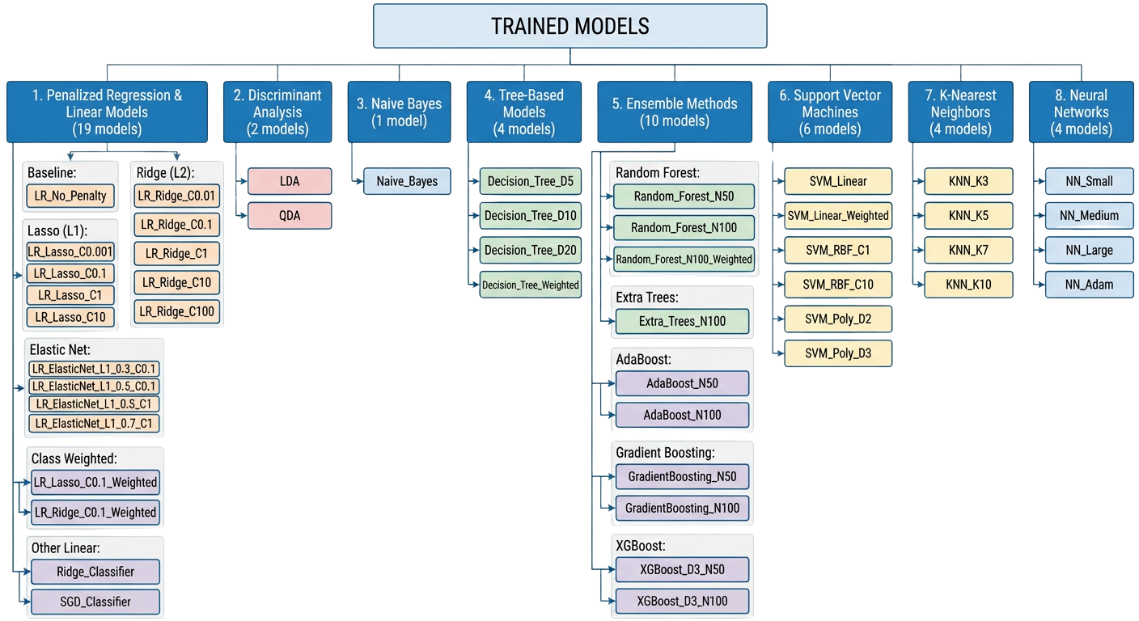
Overview
Background
Methodology
Nested CV
Results
Discussion

Slide 6
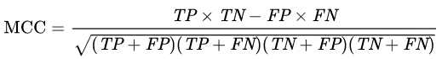
Overview
Background
Methodology
Nested CV
Results
Discussion
MATTHEWS CORRELATION COEFFICIENT (MCC)
Where
Key Interpretation
TP (True Positives) = Correctly predicted TOXIC molecules
TN (True Negatives) = Correctly predicted NON-TOXIC molecules
FP (False Positives) = Non-toxic predicted as toxic (false alarm)
FN (False Negatives) = Toxic predicted as non-toxic (DANGEROUS!)
MCC = +1.0 → PERFECT prediction (all four metrics = 100%)
MCC = 0.0 → RANDOM guessing (model has NO discriminative power)
MCC = -1.0 → INVERSE prediction (consistently WRONG!)

Slide 7
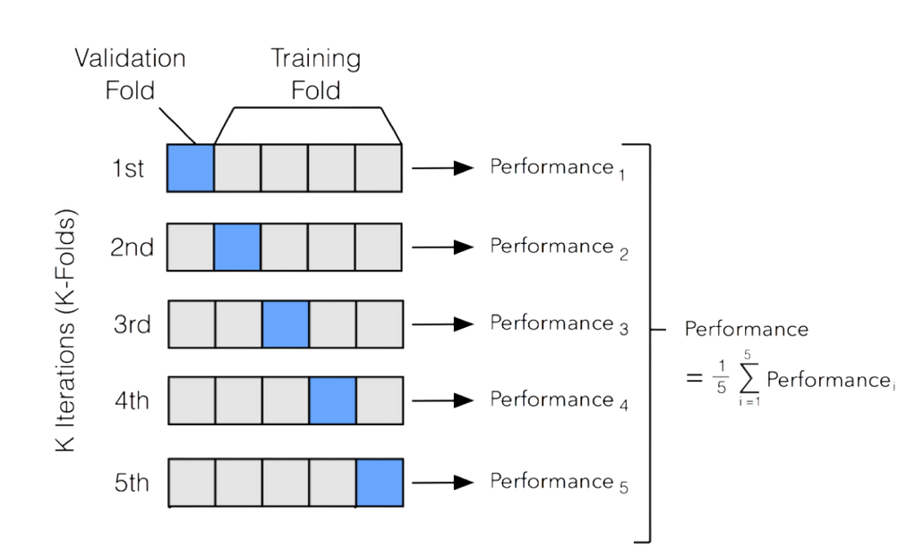
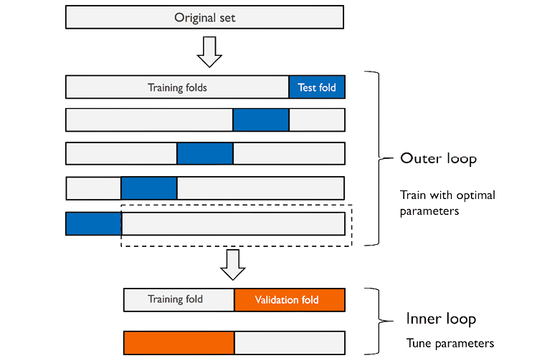
Overview
Background
Methodology
Nested CV
Results
Discussion
STANDARD CROSS-VALIDATION
NESTED CROSS-VALIDATION
5-fold CV → Hyperparameter tuning
Performance reported on SAME folds
Hyperparameters "leak" into test set
BIASED UPWARD (optimistic!)
Risk: Looks good on data you've tuned on but may fail on truly new data!
OUTER LOOP
5-fold split (Fold 1 Test)
INNER LOOP:
5-fold hyperparameter search (on 4 folds → find best λ, α, etc.)
Benefit: True generalization performance (no optimization bias)
Figure 6: Standard Cross-Validation Illustration
Figure 7: Nested Cross-Validation Illustration

Slide 8
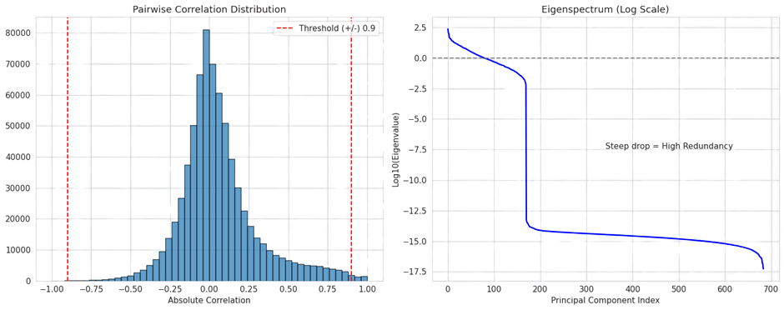
Overview
Background
Methodology
Nested CV
Results
Discussion
MULTICOLLINEARITY CRISIS
45.3%
of features have VIF > 10
(SEVERE!)
What does this mean?
Feature is 90% explained by other features
Redundant information in the design matrix
Unstable coefficient estimates
Feature selection becomes unreliable
Figure 8: Pairwise Correlation Distribution & Eigenspectrum of the Features
Implications for Penalized Regression
Lasso can't reliably select "THE" important feature (When 5 features contain the same signal, Lasso picks arbitrarily)
Ridge coefficients become arbitrary (Different correlated features can explain same relationship)
Elastic Net offers some help but can't solve fundamental issue
Feature stability selection is therefore ESSENTIAL (see which features selected >70% of the time across resamples)

Slide 9
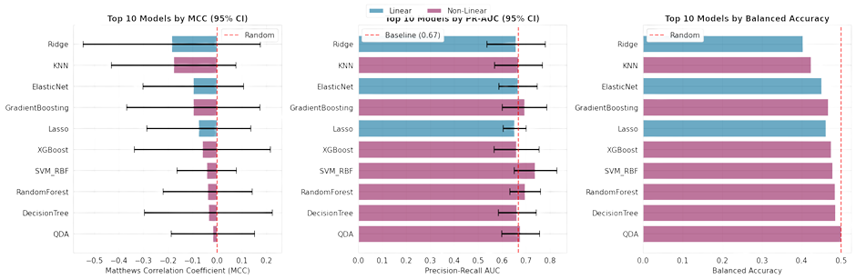
Overview
Background
Methodology
Nested CV
Results
Discussion
RANDOM GUESSING
Our Findings
Mixed results show performance near random (>50% accuracy is NOT impressive for 67% majority class baseline!)
-0.076
Interpretation
MCC = 0 → Random guessing
MCC < 0 → Worse than random (models are being fooled!)
Our best MCC
Dataset is TOO SMALL & TOO NOISY
Figure 9: Nested CV Model Performance Metrics

Slide 10
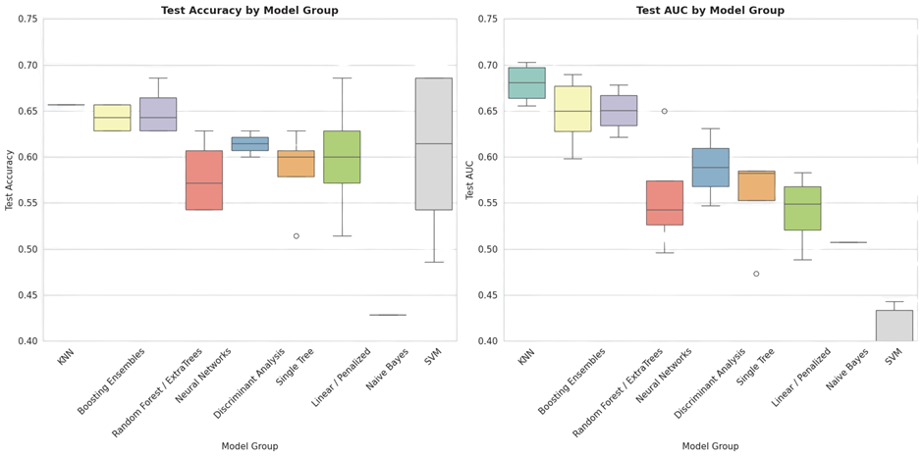
Overview
Background
Methodology
Nested CV
Results
Discussion
WHY DID PRIOR STUDY GET 79.53%?
The prior 79.53% accuracy was OPTIMISTICALLY BIASED
Our more honest assessment: Models cannot predict CRY1 toxicity with this dataset size
Prior Study Protocol (Gul et al., 2021):
Used standard (non-nested) 5-fold CV
Tuned hyperparameters on CV folds
Reported performance on SAME CV folds
Result: Claimed 79.53% accuracy
The Problem:
When you tune hyperparameters on data you'll later test on, the model inadvertently overfits to the hyperparameter search process itself.
This "hyperparameter leakage" makes results look 20-30% better!
Our Solution (Nested CV):
Hyperparameter tuning on completely separate inner folds
Testing on truly held-out outer folds
No information leakage
True generalization performance: Negative MCC!
Figure 10: Deceptive Model Performance Metrics (Accuracy & AUC)

Slide 11
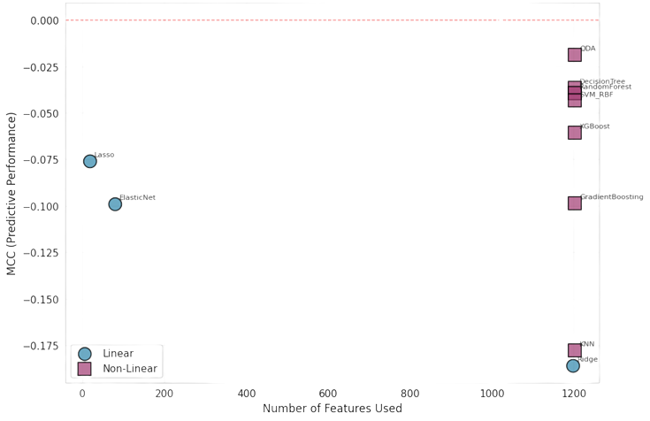
Overview
Background
Methodology
Nested CV
Results
Discussion
PENALIZED REGRESSION FAILED
Model
Mean MCC
95% CI MCC
Avg. Features
Lasso (L1)
-0.076
[-0.287, +0.135]
17.6
Elastic
-0.099
[-0.303, +0.106]
79.2
Ridge (L2)
-0.186
[-0.546, +0.174]
1197
Interpretation
Ridge: shrinkage without selection leaves mostly noise.
Lasso: extreme sparsity under multicollinearity likely discards signal with noise.
Elastic Net: intermediate sparsity, but still not significant.
Takeaway: In this regime (p/n ≈ 7.04, VIF ~ 10⁷), neither sparse linear models nor complex models using all features reliably extract signal; non-linear models trend better than linear, but uncertainty remains high.

Slide 12
Overview
Background
Methodology
Nested CV
Results
Discussion
PRACTICAL RECOMMENDATIONS
If you want to build a working toxicity predictor for CRY1.....
SHORT TERM (with current 171 molecules)
MEDIUM TERM (expand dataset)
LONG TERM (methodological best practices)
Use Lasso/Ridge for parsimony (select ~45 stable features
Report negative MCC honestly (model doesn't generalize)
Do NOT claim this model can predict toxicity
Use it as exploratory tool to identify candidate features
Conduct experimental toxicity screening on ~300-500 CRY1 molecules
Augment UCI dataset with new compounds
Re-validate models with expanded dataset (target: MCC > 0.3)
Design future studies with nested CV from inception
Combine molecular descriptors with structural information
Leverage transfer learning from other toxicity datasets
Conduct prospective validation on newly synthesized compounds
Always report feature stability, not just coefficients

Slide 13
Overview
Background
Methodology
Nested CV
Results
Discussion
SUMMARY OF FINDINGS
LIMITATIONS OF THIS WORK
Question 1:
Can penalized regression predict CRY1 toxicity?
Single dataset (UCI Toxicity-2)
Generalizability limited to CRY1-targeting compounds
Other molecular classes may behave differently
Answer:
NO (with 171 molecules)
Best MCC = -0.076 (negative, worse than random)
All 50+ models fail despite algorithmic sophistication
Problem is fundamental (too few samples), not method
Molecular descriptors only
Did not incorporate 3D structural information
Did not use docking scores or binding affinity data
Limited to chemoinformatics, not cheminformatics
Question 2:
Why did prior study claim 79.53%?
Answer:
Optimization bias from non-nested CV
Hyperparameter tuning leaked into test evaluation
Honest nested CV reveals true (negative) performance
Question 3:
What's the bottleneck?
Answer:
Sample size, not features or algorithms
Multicollinearity is severe (45% VIF > 10) but manageable
Question 4:
What can we trust?
Answer:
Only ~3.7% of features are stably selected
These 45 features may reflect true biology
But their signal is too weak to predict with n=171

Slide 14
Overview
Background
Methodology
Nested CV
Results
Discussion
BSc (Hons.) in Mathematics & Statistics
THANK YOU SO MUCH!
GINNI Vishal (22203133)

